Slide 1
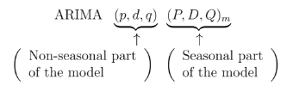
ARIMA Models[Auto Regressive integrated with Moving Average]
Background:
p – number of autoregressive terms.
d – number of non-seasonal differences needed for stationarity.
q – number of lagged forecast errors in prediction equation.
Note:
auto.arima(x)
v/s
auto.arima( x, stepwise=FALSE, approximation=FALSE )

Slide 2
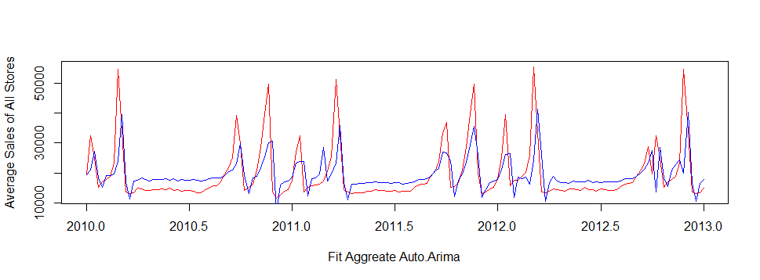
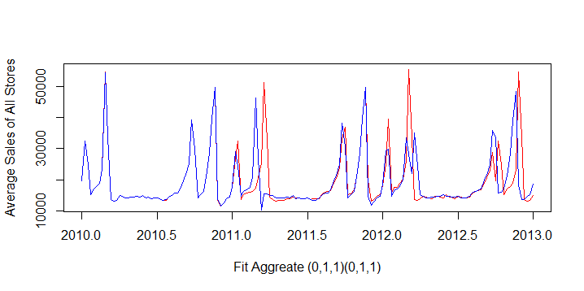
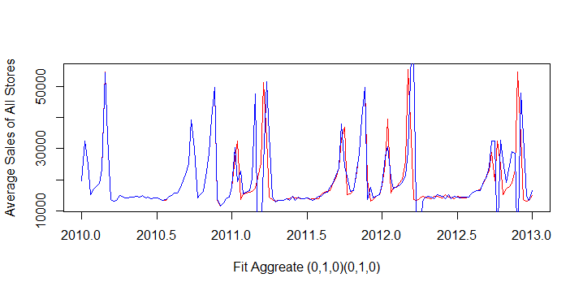
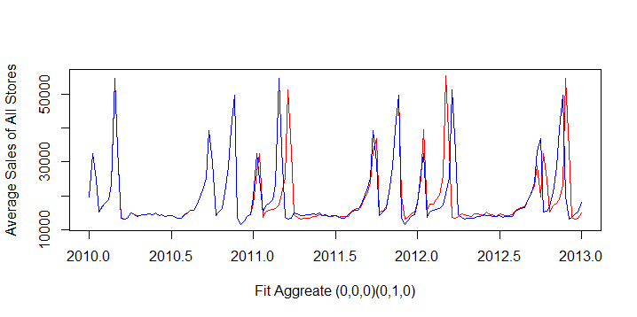
Step-1: Analyze Different Models –Datasets(Store Type : A+B+C)
AIC – Akaike information criterion
MAPE – Mean Absolute Percentage Error
Model | AIC | MAPE | Graph
auto.arima | 3252 | 22
General Season Trend | 2214 | 11
Seasonal Random Trend | 2248 | 17
Season Random Walk | 2236 | 14

Slide 3
Step-2: Analyze Different Models – Individual Dataset
Datasets | Model | AIC | MAPE
Store Type A | auto.arima | 3293 | 22
 | General Season Trend | 2234 | 11.6
 | Seasonal Random Trend | 2267 | 14
 | Season Random Walk | 2257 | 15
Store Type B | auto.arima | 3255 | 23
 | General Season Trend | 2215 | 12
 | Seasonal Random Trend | 2248 | 18
 | Season Random Walk | 2237 | 15
Store Type C | auto.arima | 2854 | 13
 | General Season Trend | 1926 | 7.7
 | Seasonal Random Trend | 1987 | 11
 | Season Random Walk | 1942 | 8

Slide 4
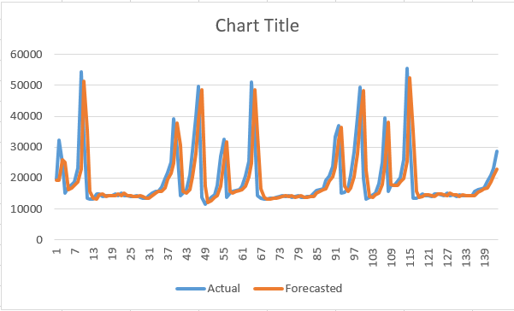
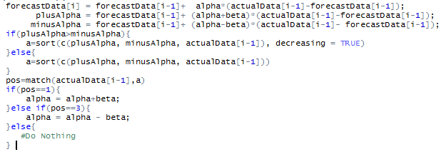
Adaptive Smoothing.
Adaptive Smoothing is as same as Exponential Smoothing, but alpha value will not be constant while calculating each forecast values.
For our study,
α = 0.3, β = 0.2
F_{t} = F_{t-1} + α(A_{t-1} - F_{t-1})
+ α = F_{t-1} + (α+ β)(A_{t-1} - F_{t-1})
- α = F_{t-1} + (α− β)(A_{t-1} - F_{t-1})
F_{t+1} = F_{t} + α (A_{t} - F_{t})
.
.
.
MAPE: 20.68466

